Slide 1


SEGMENTAREA TOPICALĂ A DOCUMENTELOR TEXT
Alexandru Pârvu
Machine Learning Engineer

Slide 2
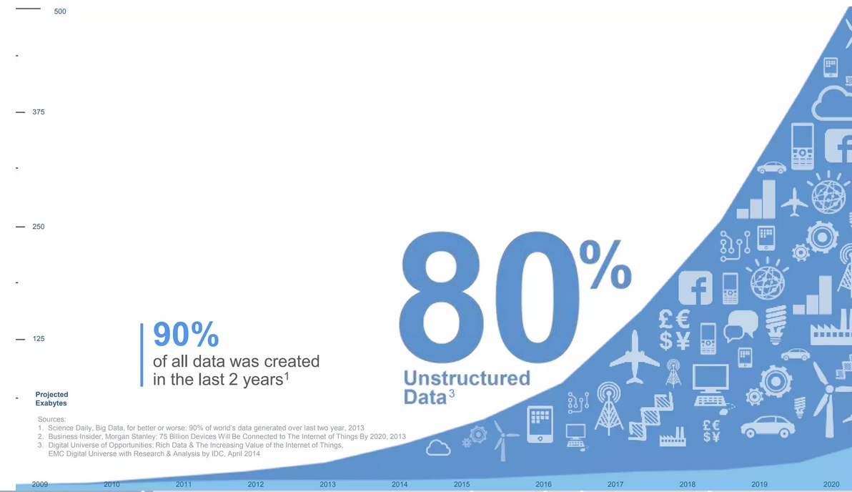

Problema?
Majoritatea datelor generate nu sunt structurate,
Cea mai mare parte din aceste informații sunt sub forma de text
AGENDA
TOWN HALL

Slide 3
Exemple:
1. Articole (Știri, științifice, etc.),
2. Comment-uri,
3. Review-uri,
4. Versuri.
Toate aceste surse prezenta problema informațiilor inaccesibile

Slide 4
Posibile Soluții :
Stabilirea unei convenții de etichetare apriori
Filtrarea după cuvinte cheie
Un sistem de segmentare (clustering) tradițional
Limitări:
Pentru cazul 1 și 2 nu avem nici o garanție ca aceste convenții sunt aplicabile sau vor fi pe viitor,
Pentru cazul 3 nu putem discerne particularitățile fiecărui segment

Slide 5
Algoritmi alternativi de segmentare:
Alocare Latent Dirichlet
Factorizarea Matricelor Non Negative
Asumații:
Documentele se vor segmenta in jurul unor cuvinte sau serii de cuvinte cheie
Fiecare Topic are o serie de cuvinte cheie cu o probabilitate ridicata de a fi folosite în cadrul acelui Topic

Slide 6



Surse de date:
NPR – articole de știri
Spotify – lirici de cântece
Women’s clothing – review-uri haine
: 9,2 Mil cuvinte
: 12,6 Mil cuvinte
: 1,2 Mil cuvinte
11,47 x Biblia
15,67 x Biblia
1,51 x Biblia

Slide 7
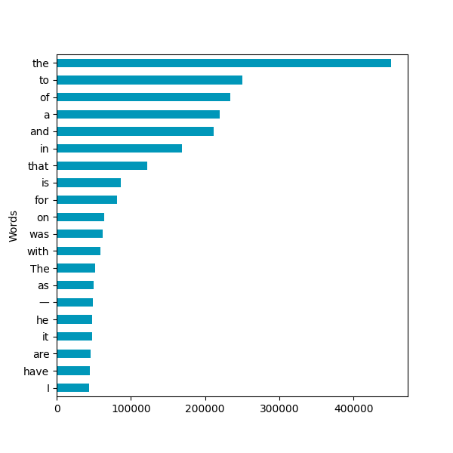
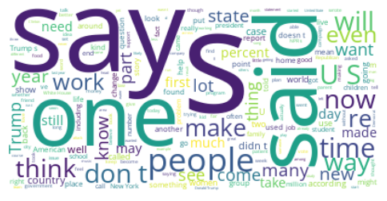
NPR:

Slide 8
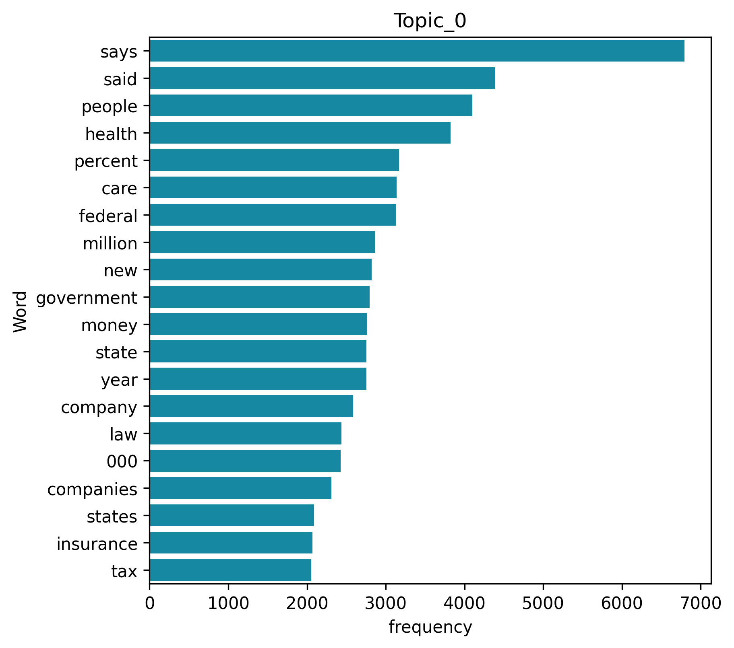
NPR:
Topicul:
0 : Finance (Finanțe)
1 : International News (Știri Internaționale)
2 : National or Local News (Știri Naționale sau Locale)
3 : Medical Research (Cercetare Medicală)
4 : Presidential Election (Alegerile Prezidențiale)
5 : Cultural News (Știri Culturale)
6 : Education (Educație)

Slide 9
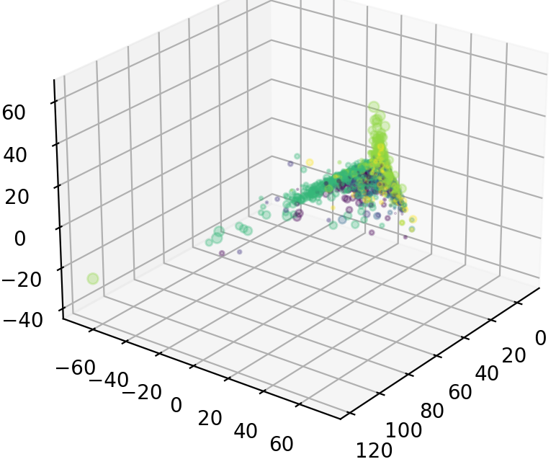
NPR:
Topicul:
0 : Finance
1 : International News
2 : Local News
3 : Medical Research
4 : Presidential Election
5 : Cultural News
6 : Education

Slide 10
Exemple:
Cultural News
”Order in the court — but maybe not in movie theaters. With all the talk lately about politics and the judiciary — fights over Supreme Court vacancies, the President complaining about”” judges — I’ve been thinking about the judges I’ve seen on screen, and how their depiction might have intersected with public opinion through the years”
Finance
”Updated at 2:30 p. m. ET, for years, Puerto Rico has grappled with an debt crisis, watching as its bills have grown to more than $70 billion. Including what the U. S. territory owes to pension funds, that debt exceeds $120 billion. Now, Puerto Rico’s struggle with its creditors has stepped into U. S. federal court, where an unprecedented case”

Slide 11
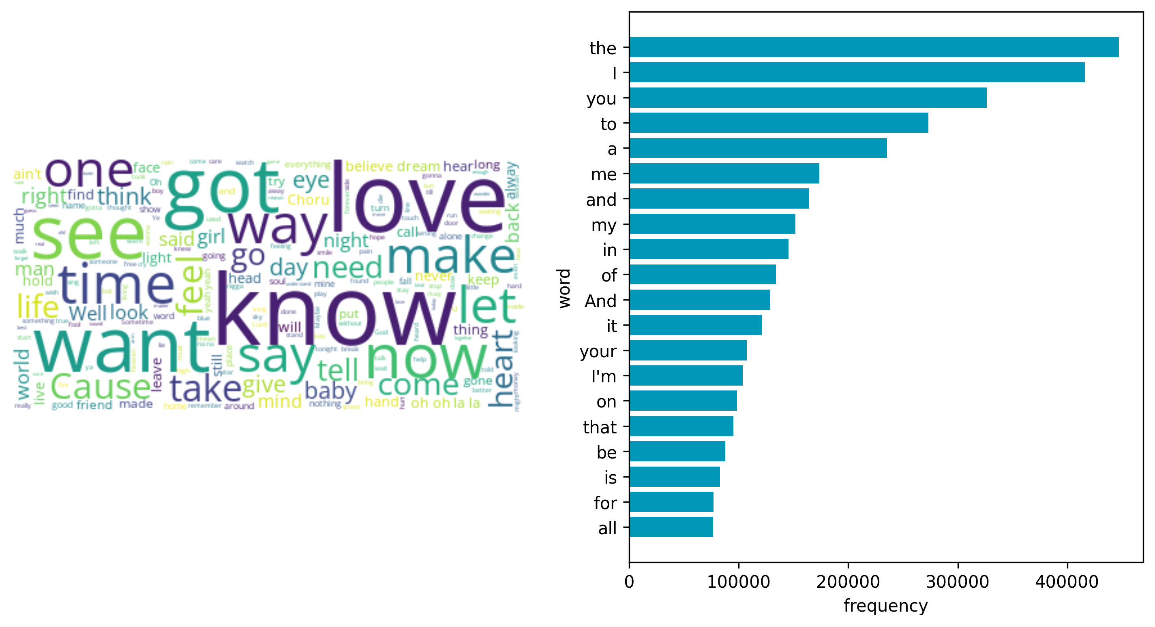
Spotify:
Cele mai frecvente cuvinte sunt in continuare cuvinte de stop ale limbi engleze
Fără sa luăm in considerare aceste cuvinte, cele mai frecvent vor fi cele de natură sentimentală
Notes:
Grant access but make it specific

Slide 12
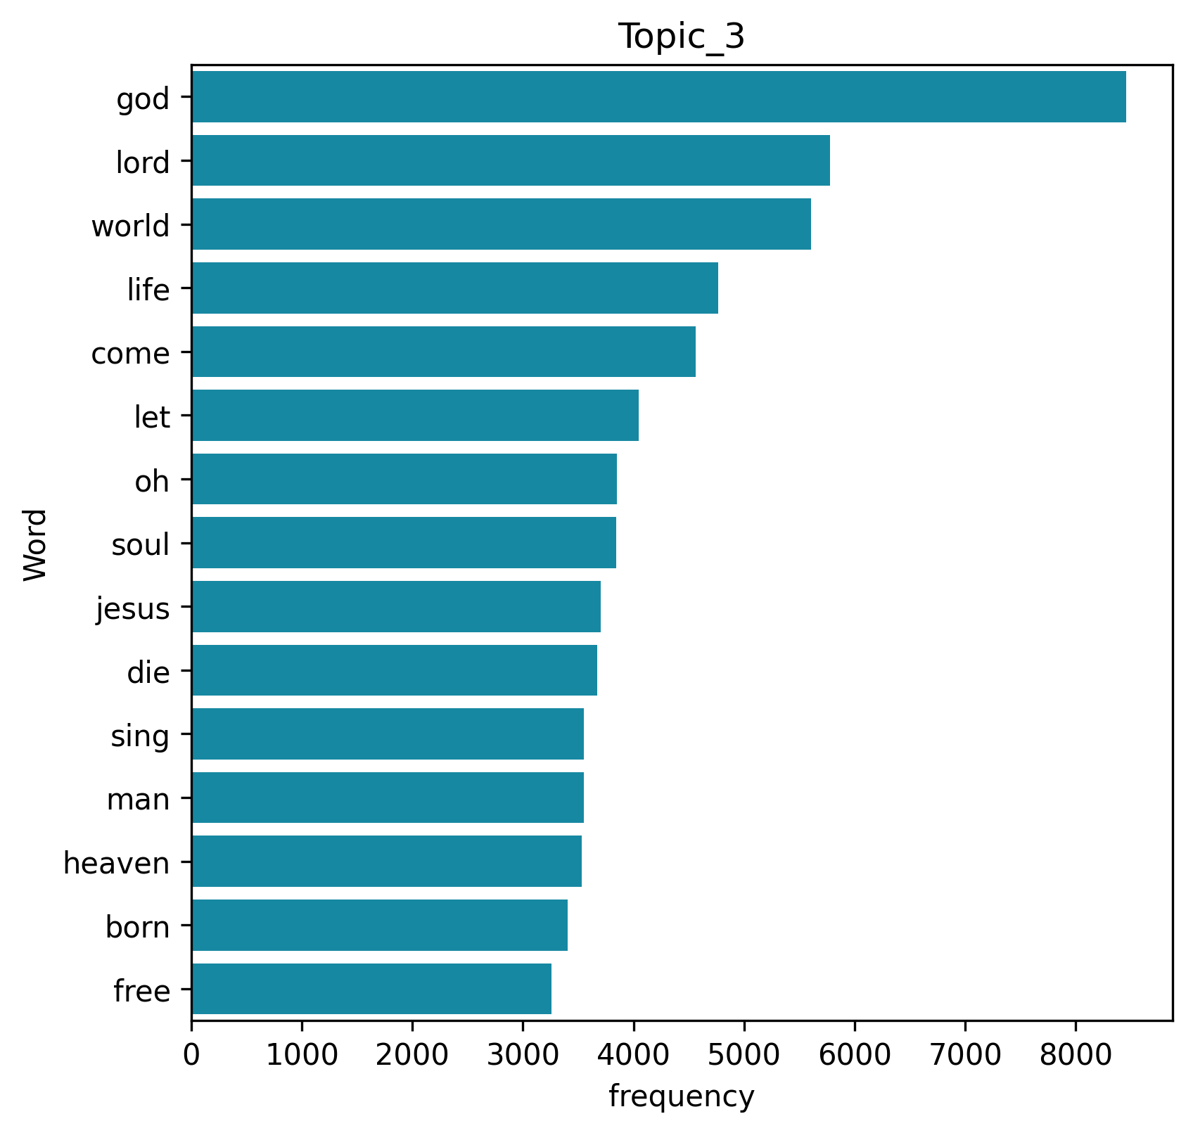
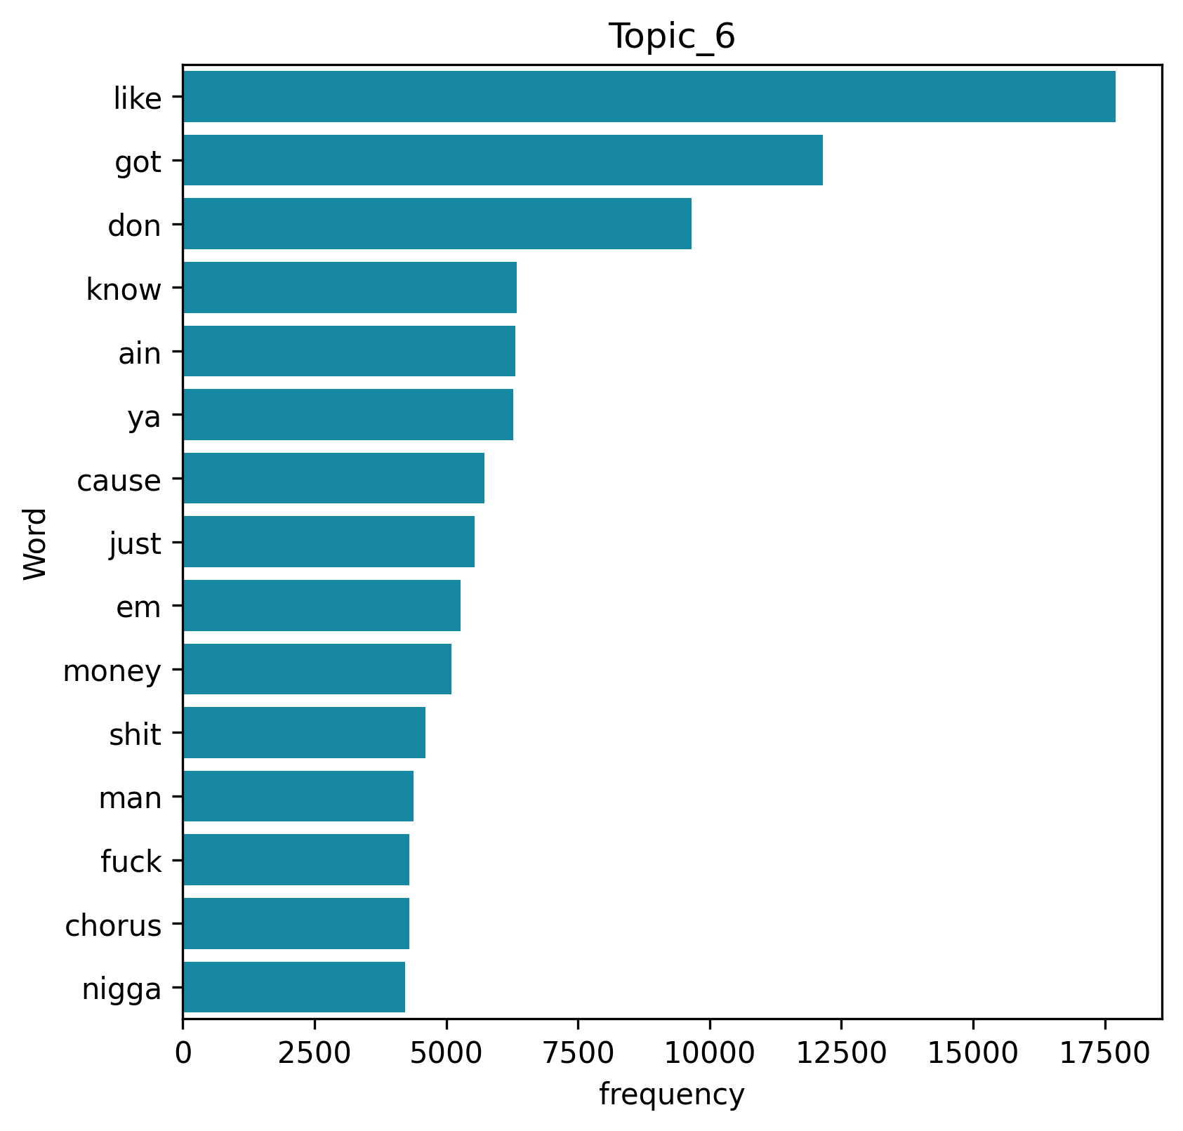
Spotify:
Divine
Rap
Notes:
Grant access but make it specific

Slide 13
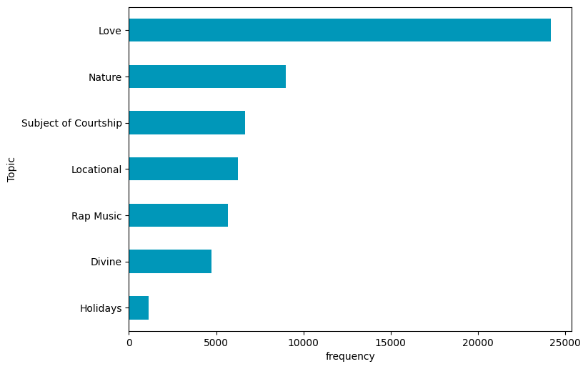
Spotify:
Topic_0: Subject of a Courtship,
Topic_1: Nature,
Topic_2: Love,
Topic_3: Divine,
Topic_4: Locational in nature,
Topic_5: Holidays,
Topic_6: Rap Music.
Notes:
Grant access but make it specific

Slide 14
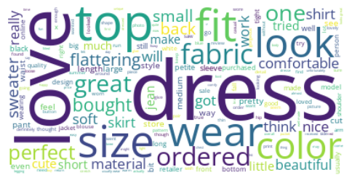
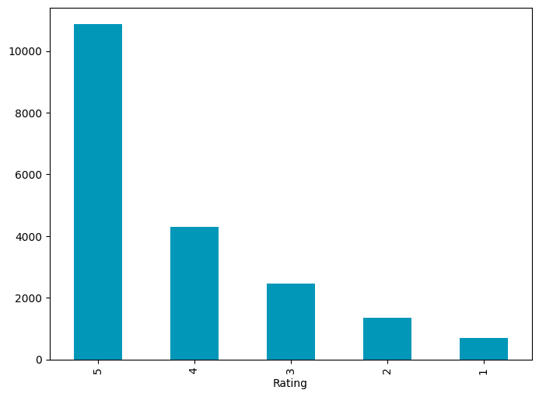
Women’s Clothing :
Notes:
Grant access but make it specific

Slide 15
Material and Color
I'm not usually a fan of simple crewneck sweaters but this one has some nice added details that make it a keeper. the dark red oxblood color is really nice (it manages to be a red sweater without feeling overly holiday), the detailing at shoulder/chest is interesting yet subtle enough to not be distracting and doesn't feel bulky at all, the dropped shoulder seams are done correctly and without the body becoming boxy. it does feel like it might run a tad bit large, but only very slightly,
Women’s Clothing :
Topic_0: Sale,
Topic_1: Fit,
Topic_2: Comfort,
Topic_3: Small Sizes,
Topic_4: Material and Color,
Topic_5: Appearance,
Topic_6: Dresses.
Appearance
I love natural colors and nature themes but this top was a disappointment. i ordered both the small and the xs because retailer can run very large. the small was too big and the xs did not hang correctly, the arms hit at a weird spot and the neckline wouldn't sit right. overall the fit was boxy and unflattering. the fabric is pretty but the style is well....boring. there was just no wow factor for me. i think the fabric deserved a much better design.
Notes:
Grant access but make it specific

Slide 16
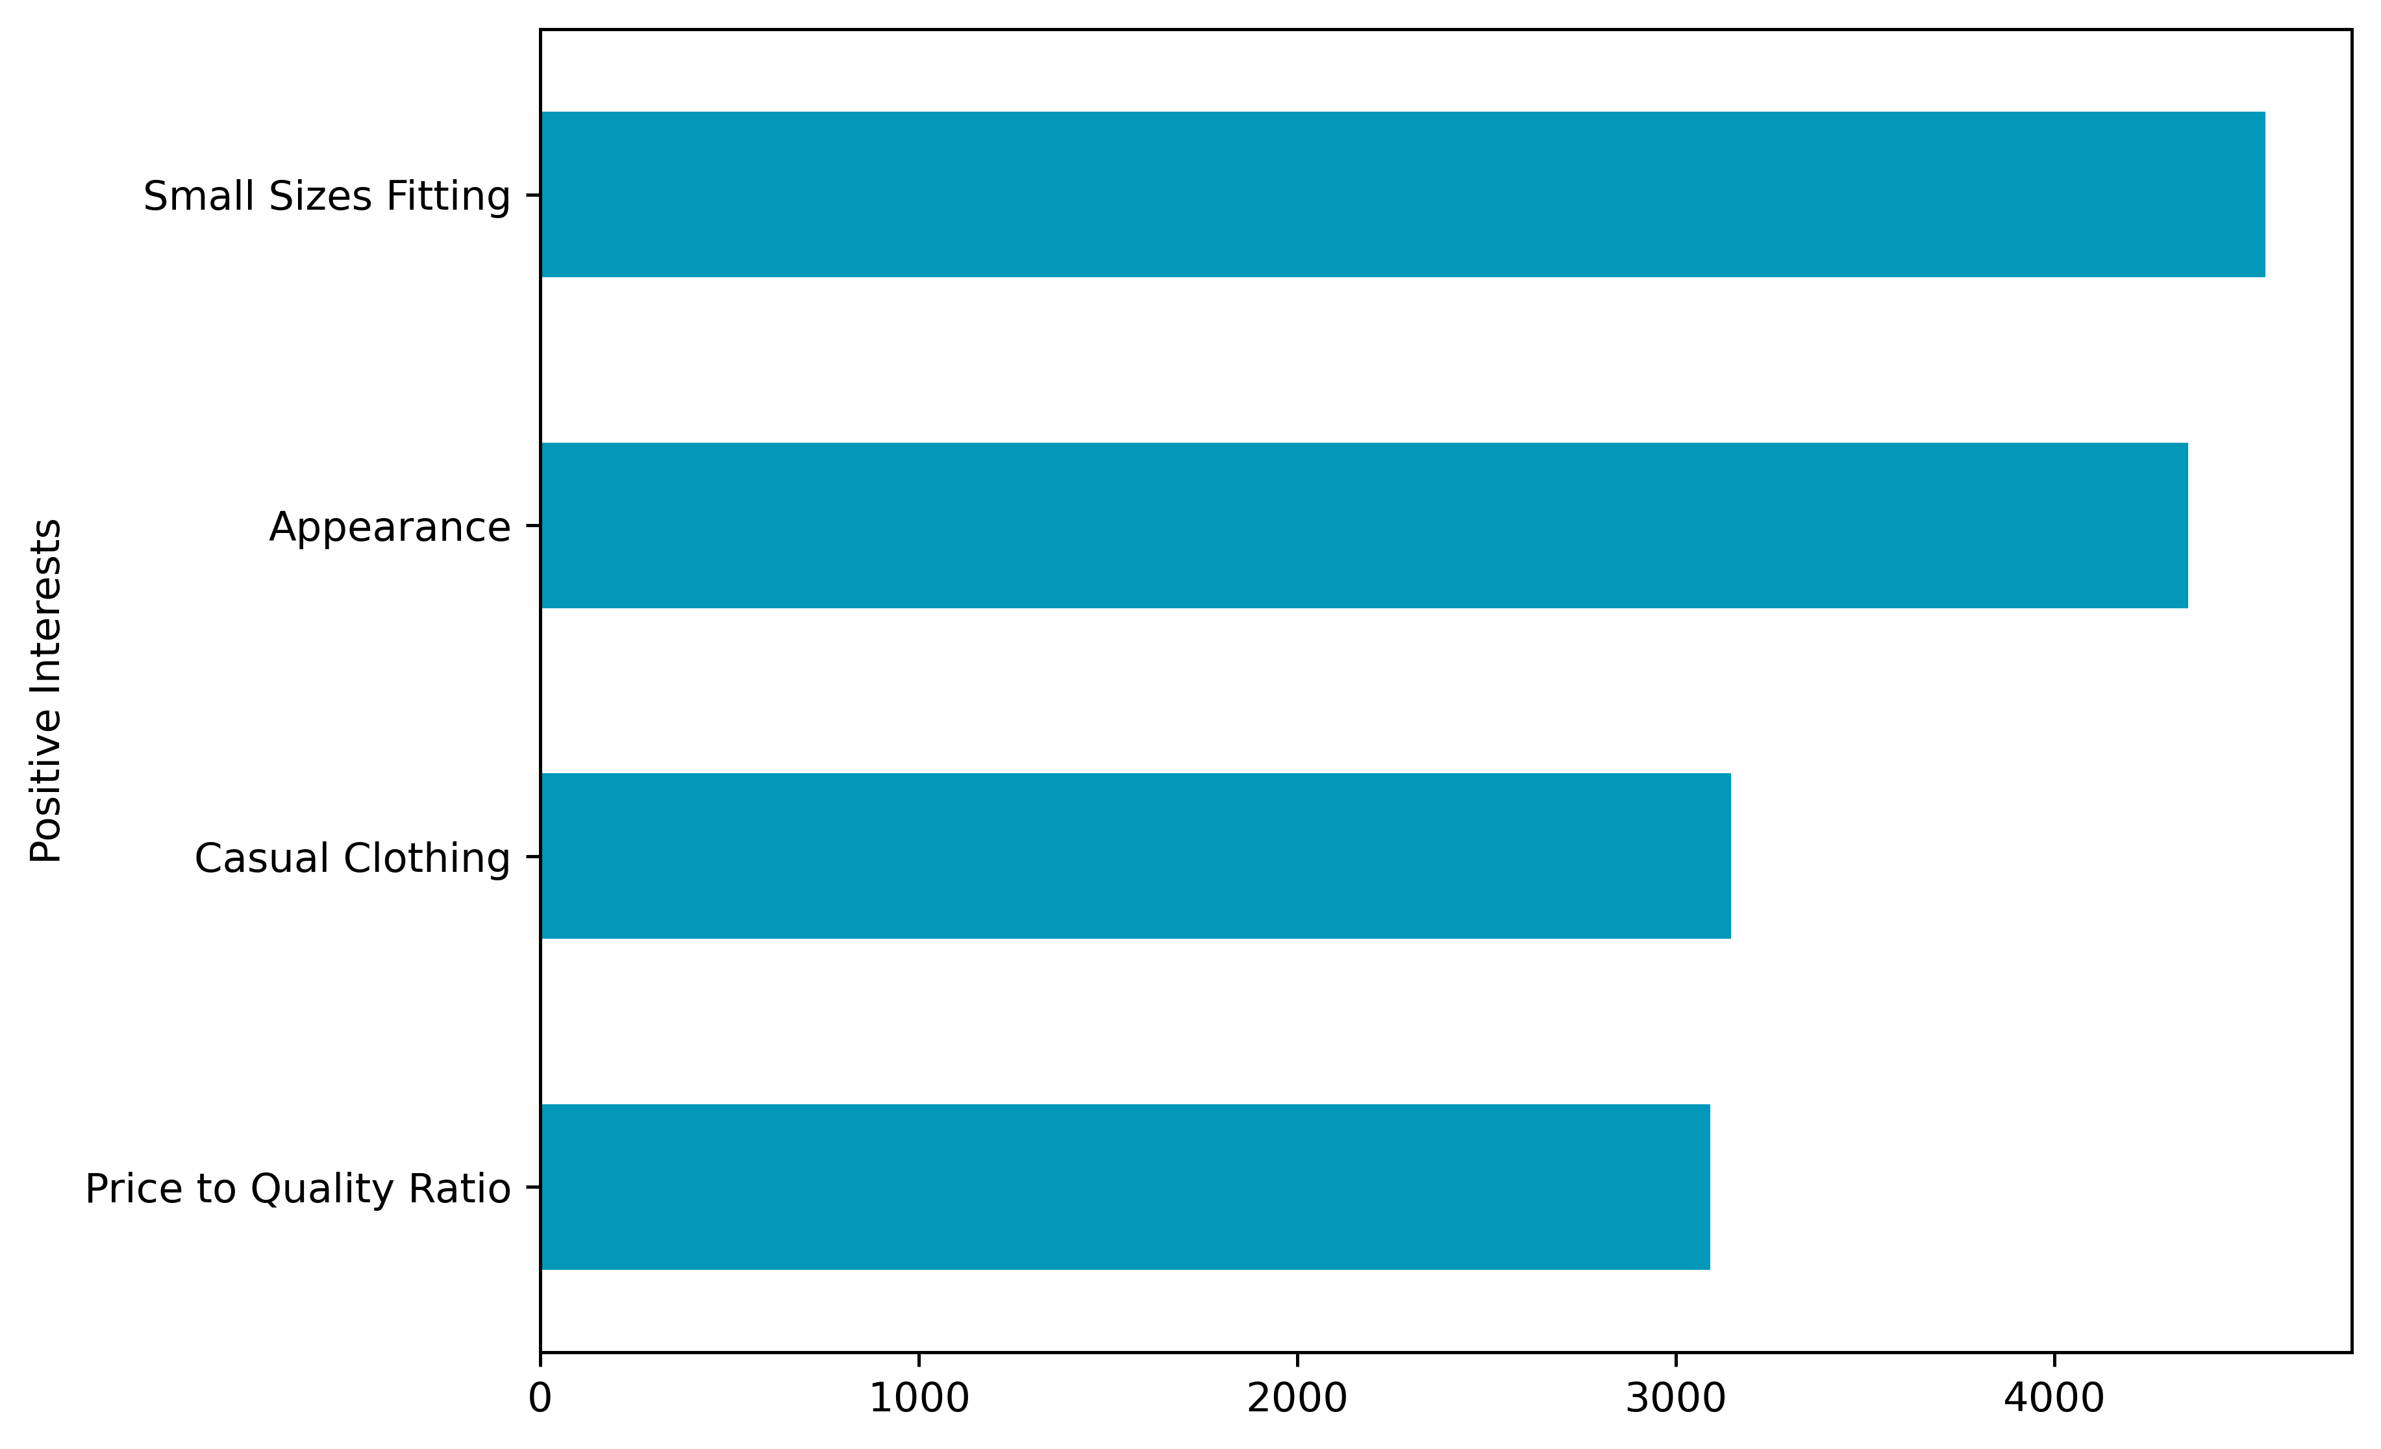
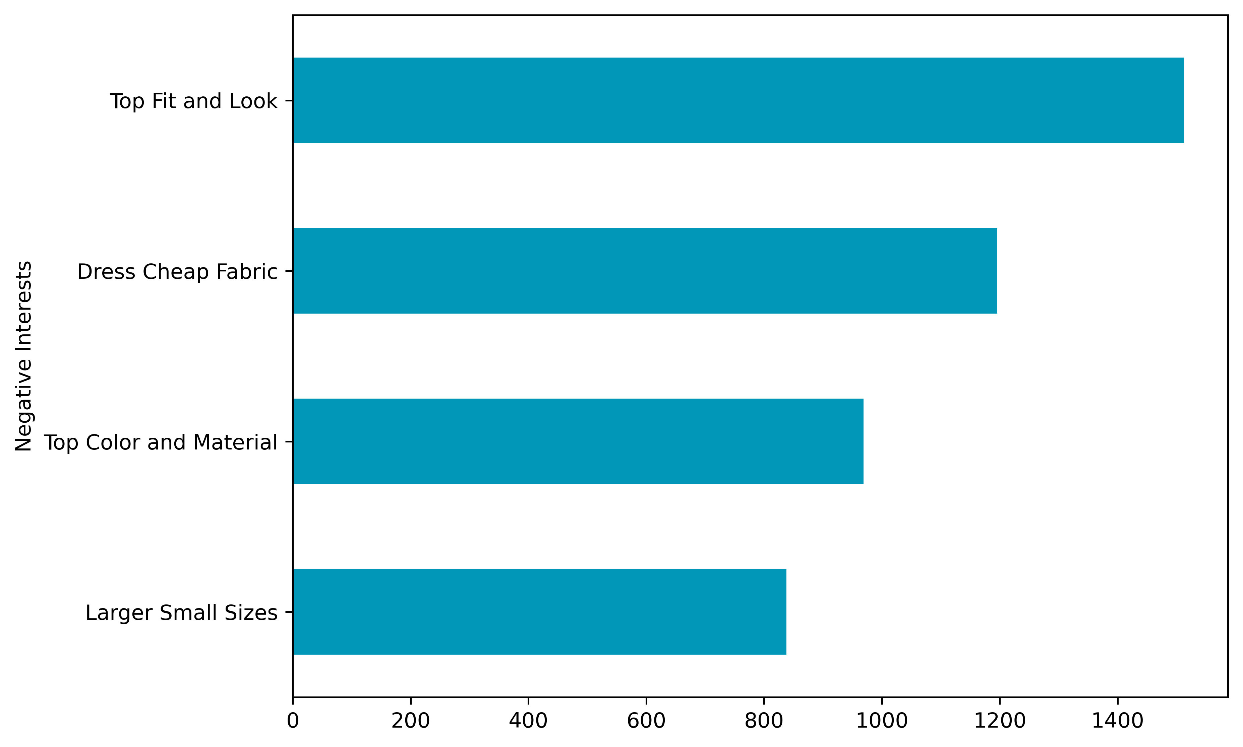
Women’s Clothing :
Pozitive
Negative
Notes:
Grant access but make it specific

Slide 17
THANK YOU

